Slide 1
Understanding Chaucer tips & Tricks
Torrie Bent

Slide 2
footnotes
While reading, you will notice there are little numbers in superscript form above some words.
Superscript numbers indicate there is a footnote at the bottom of the page. Match the number at the bottom with the number after the word in the text.
Footnotes will provide some explanation of the word, making it easier to understand the line.

Slide 3
Let’s look at an example
In “The Wife’s Lament,” The second stanza starts off with a line that includes a superscript number.
The line, “First my lord departed from his people over tossing waves…” (6) can call for some confusion. One would think she is talking about her king or ruler of her land.
When the number is matched with the footnote number, the explanation is “A woman would refer to her husband as her “lord”
Without this footnote, the entire passage may have been read with misunderstanding of the characters involved. You would not typically infer when a woman says her “lord” that she is talking about her husband

Slide 4
Breaking down the line
Footnotes are great, but can only be so useful. Providing a definition for a word makes the line easier to understand, but you may still be confused.
Breaking down the line word by word is extremely beneficial because you can focus on one part at a time.
For confusing words without footnotes, simply google the definition to provide a solid understanding

Slide 5
Examples of breaking it down
In “The Wife’s Lament,” we can look at lines 21-25. “ A happy pair we had promised each other, that death alone would ever divide us, and nothing else. All that is changed; our nearness once is now as though it never had been.”
When broken up, we can look at each piece and put it together, like a puzzle.
For example, “A happy pair”
We know that she had previously spoke of “her lord” (husband) so we can infer that a happy pair is her husband and herself

Slide 6
Example continued
“We had promised each other, that death alone would ever divide us and nothing else”
This sentence can easily be broken down to mean her husband and her made a promise to never split from one another. They agreed that death would be the only thing to come between them.
“All that is changed; our nearness once is now as though it never had been”
The understanding is that the previous line is no longer the case, they are no longer close and seems as though they never were.

Slide 7
Online help
Breaking down stanzas line by line is by far the best thing you can do while reading, however, when that is not enough sometimes online help can be very useful.
When you google the title of the piece you can include the words “modern English translation” after.
Various websites have line by line translations into modern English. The lines are always going to be easy to understand once they are put into todays language.

Slide 8
Online help example
Original Text
Modern Translation

Slide 9
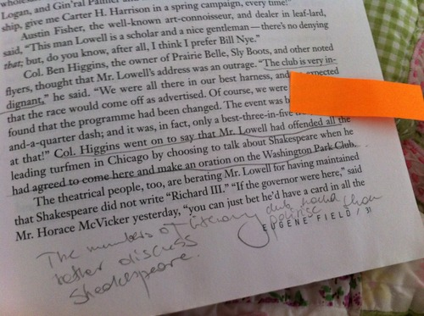
Making Notes
Once you have used footnotes, breaking it down, and online translations, it is time to make notes in your book!
Writing in your book will help you remember what you read, as well as provide a resource to go back to.
Once you have completed all of these steps, it is time to go back and read with your notes, it will help you further understand the old English language you are reading!

Slide 10
Works cited
“Footnotes and Endnotes.” Atlantis World Processor Help, www.atlantiswordprocessor.com/en/help/footnotes.htm
Heyteenbookshey. “Pet Peeve #63: Writing In Library Books.” Heyteenbookshey, 7 Oct. 2013, heyteenbookshey.tumblr.com/post/63409759530/pet-peeve-63-writing-in-library-books..
“Shakespeare Is Not ‘Old English.’” Gently Hew Stone, 9 Sept. 2010, gentlyhewstone.com/2010/09/09/shakespeare-is-not-old-english/.

